Slide 1
Presentation On Web Development

Slide 2
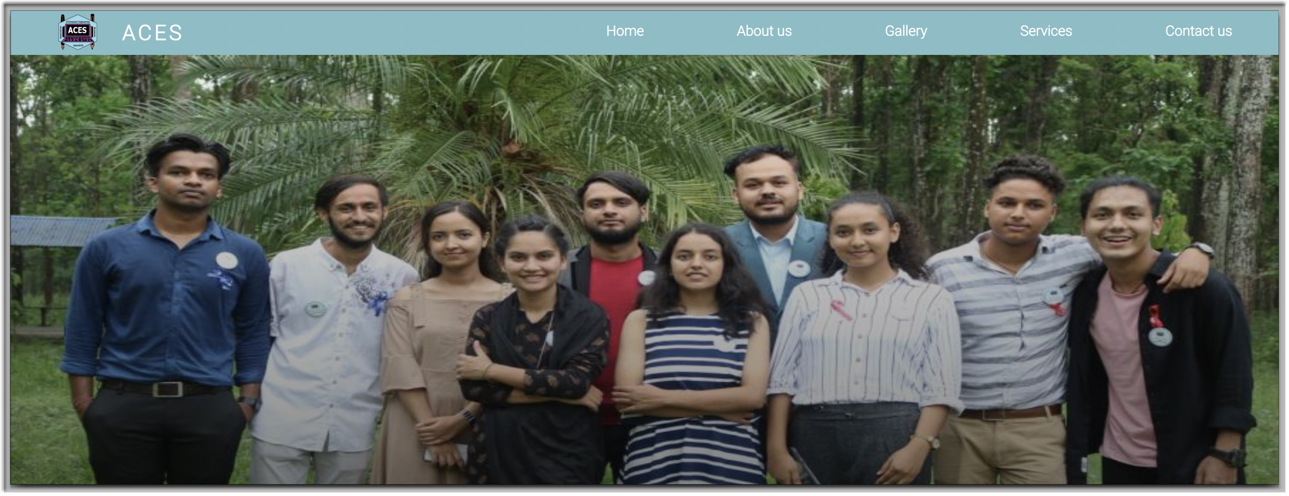
Our Webpage has
1. Navbar
2. Slider
3. About Us
4. Activities
5. Gallery
6. Contact Section
7. Footer

Slide 3
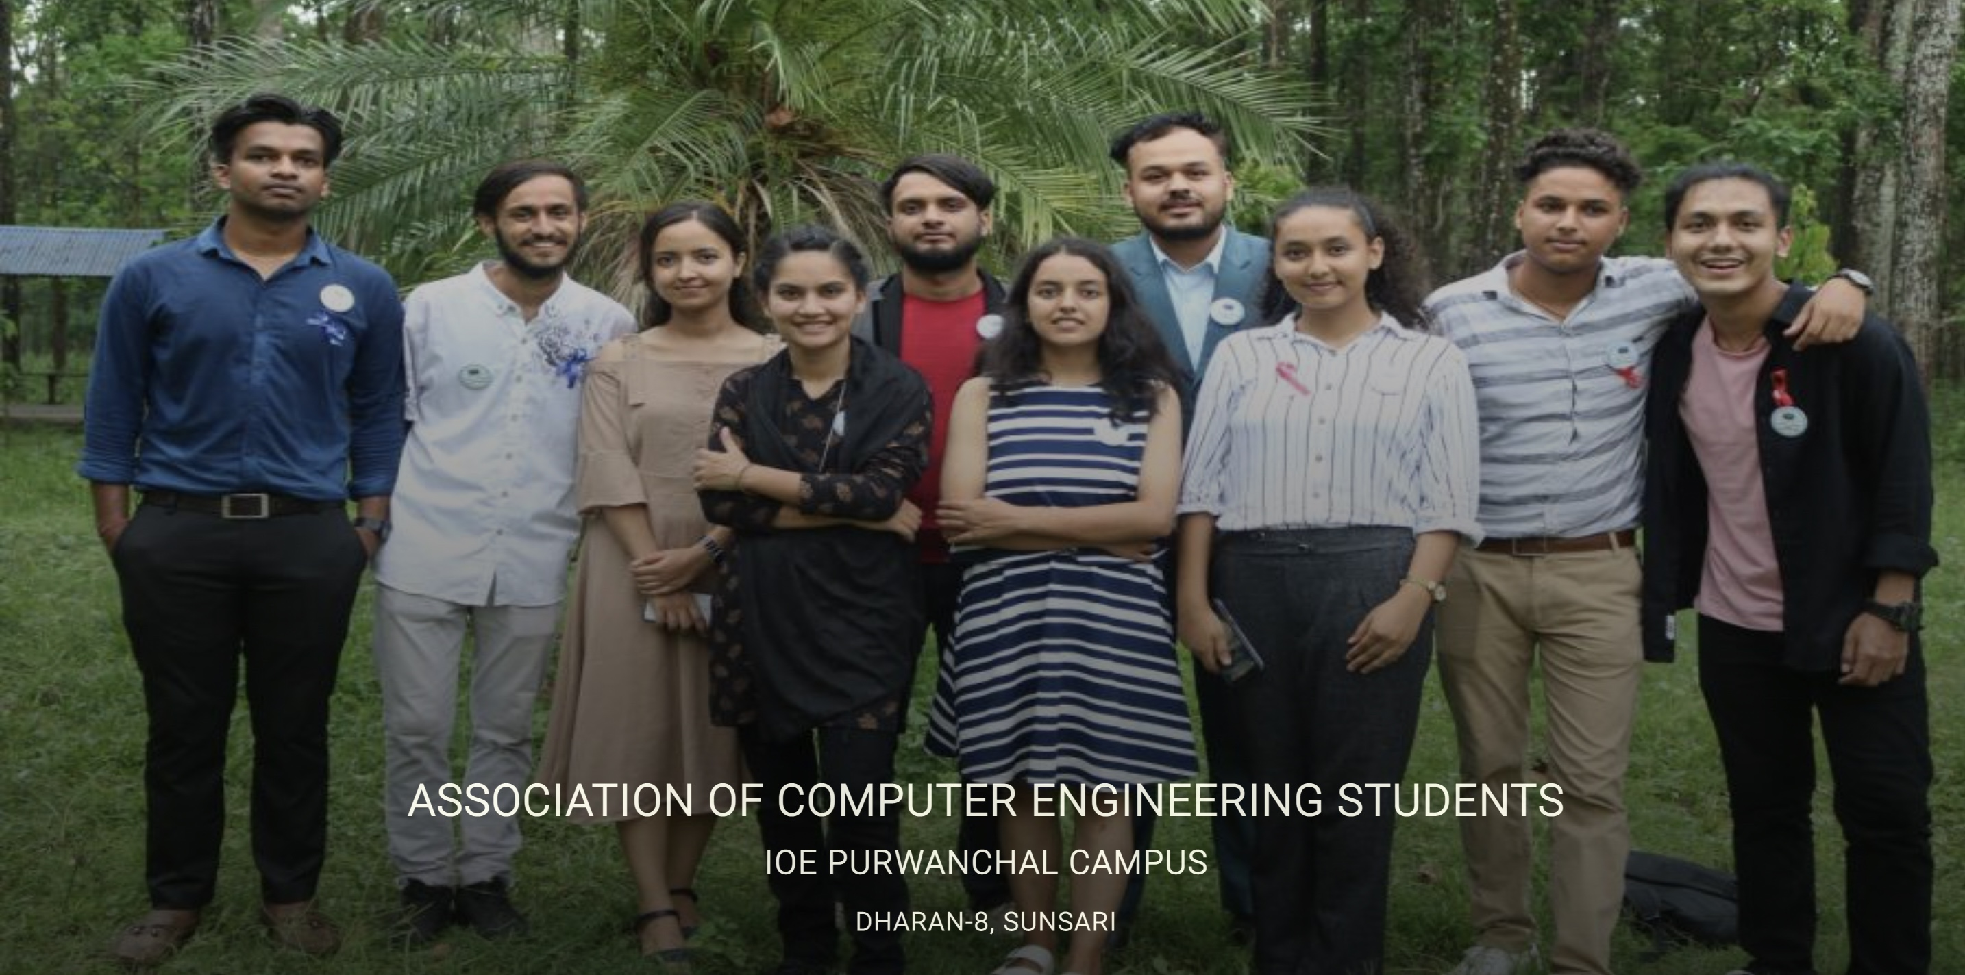
Slider

Slide 4


Slide 5
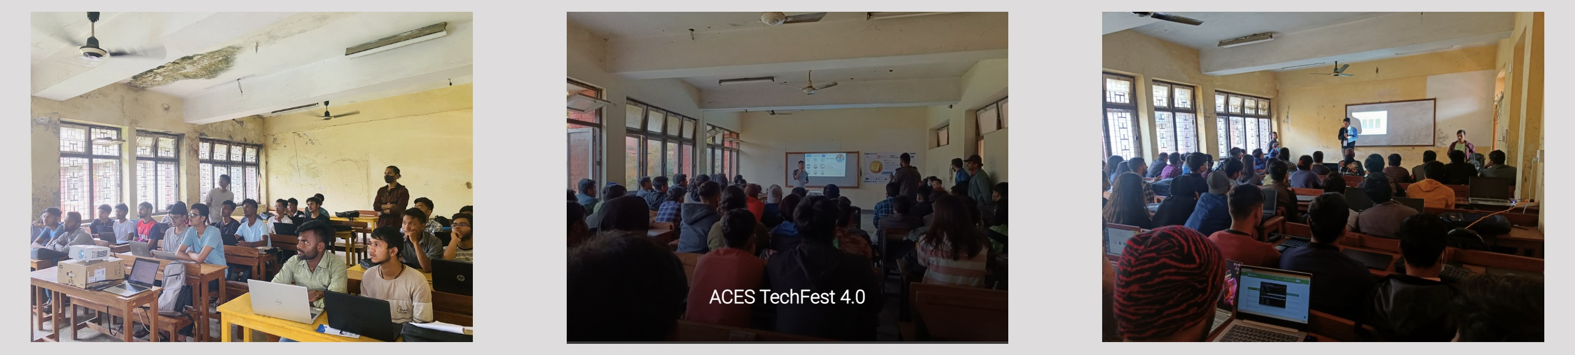
Activities

Slide 6
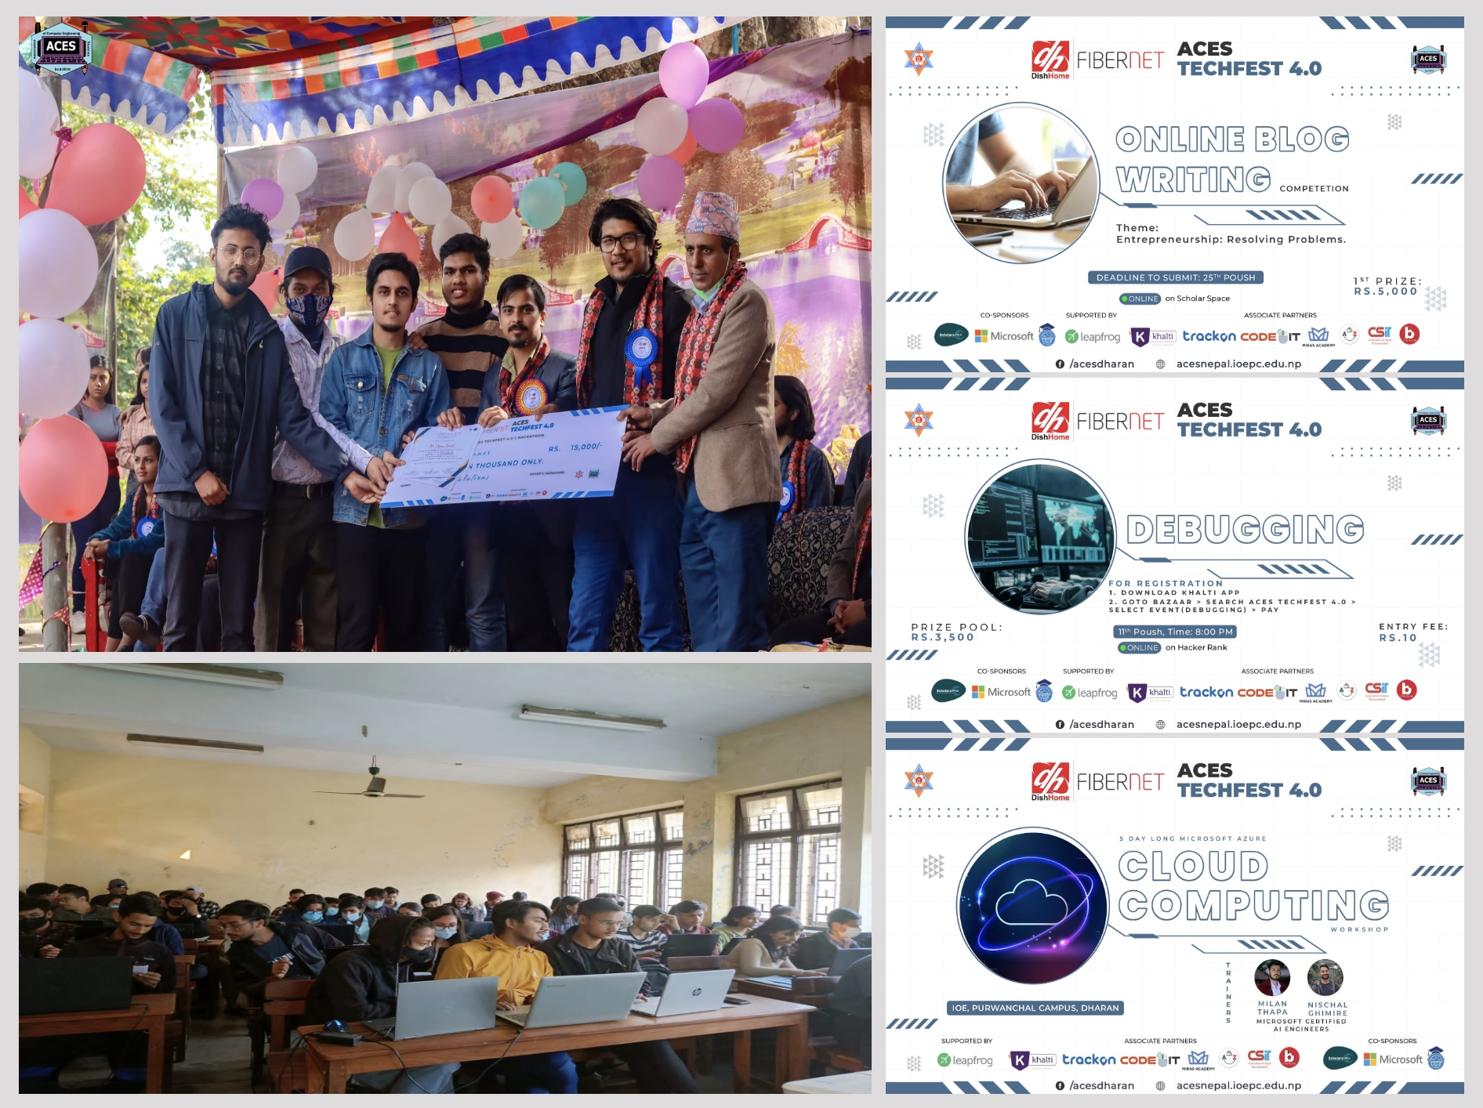
Gallery Section

Slide 7
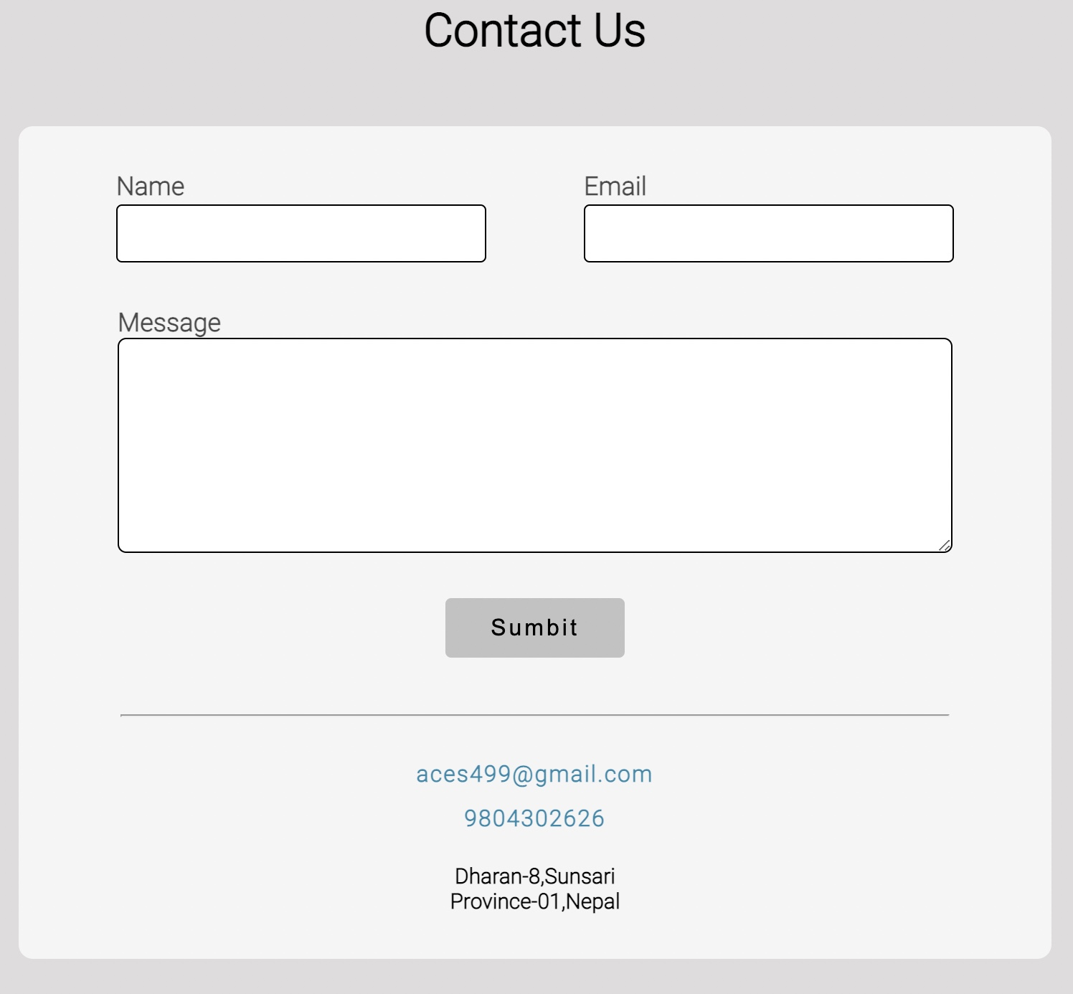
Contact Us page

Slide 8

Footer Section

Slide 9


Resources used
Resources Used

Slide 10

How our site is user friendly
Responsive Design
Hamburger Menu
Smooth Navigation Bar

Slide 11
Questions ??

Slide 12
Challenges Faced
Lack of Time
Lack of Resources
No proper design

Slide 13
Things learnt
Importance of Team Work
Importance of Proper Design and Resources

Slide 14
Thank You!!

